Slide 1

K.RAMAKRISHNAN COLLEGE OF ENGINEERING An Autonomous Institution Permanently Affiliated to Anna University Chennai, Approved by New Delhi, ISO 9001:2015, 14001:2015 certified institution, Accredited by NBA and with A grade by NAAC Samayapuram, Tiruchirappalli – 621112, Tamilnadu, India. BATCH NO: 15 A SMART GAS LEAKAGE DETECTION SYSTEM IN HOME USING IOT
UNDER THE GUIDANCE OF
DR.R.ARULRAJ,M.E,PH.ED
Assistant Professor EEE
Electrical and Electronics Engineering
K. Ramakrishnan college of Engineering,(Autonomous) Samayapuram,Tiruchirapalli-621112.

Slide 2
A SMART GAS LEAKAGE DETECTION SYSTEM IN HOME USING IOT
PRESENTED BY
EE2133 - NAVEEN PRASADH M
EE2148 - TAMIZHARASU T S
EE2151 - VIMAL KUMAR K
LEE2162 - SELVA BHARATHI R
Department of Electrical and Electronics Engineering
Third year/6th semester
K.RAMAKRISHNAN COLLEGE OF ENGINEERING
(Autonomous)

Slide 3
CONTENT
INTRODUCTION
OBJECTIVES
COMPONENTS
DATA COLLECTION
BLOCK DIAGRAM
WORKING
APPLICATION
CONCLUSION

Slide 4
INTRODUCTION
In today's fast-paced world, ensuring the safety and security of our homes is paramount. One of the critical aspects of home safety is detecting gas leaks promptly to prevent potential hazards such as fires or explosions. Traditional gas detection systems often lack real-time monitoring and remote accessibility, leaving homeowners vulnerable to undetected leaks.
A smart gas leakage detection system leverages IoT technology to provide homeowners with real-time monitoring, remote alerts, and proactive management of gas leaks.
This presentation will delve into the components, working principles, benefits, and implementation of a smart gas leakage detection system using IoT. By the end, you'll understand how this innovative solution enhances home safety and provides peace of mind to homeowners everywhere.

Slide 5
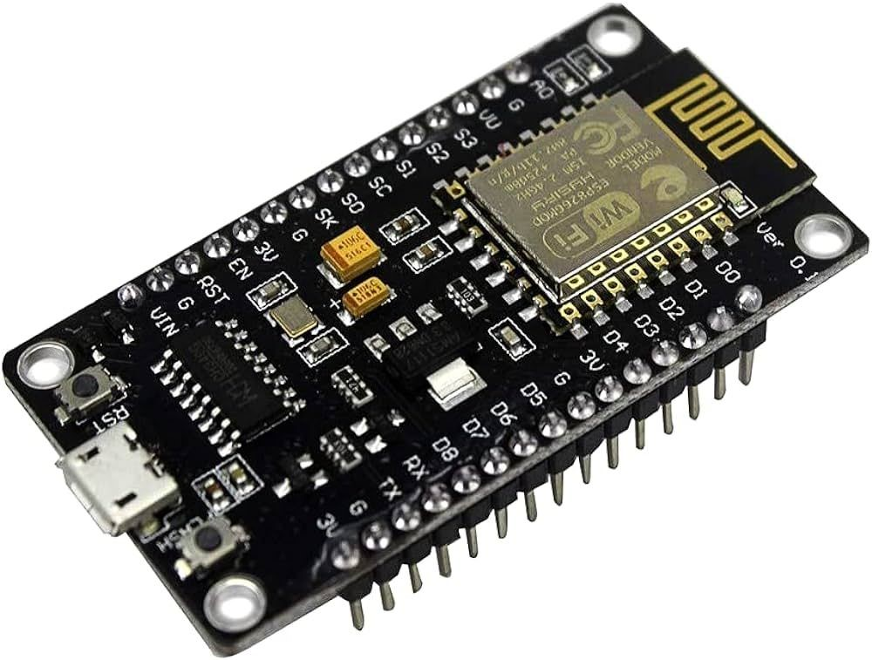
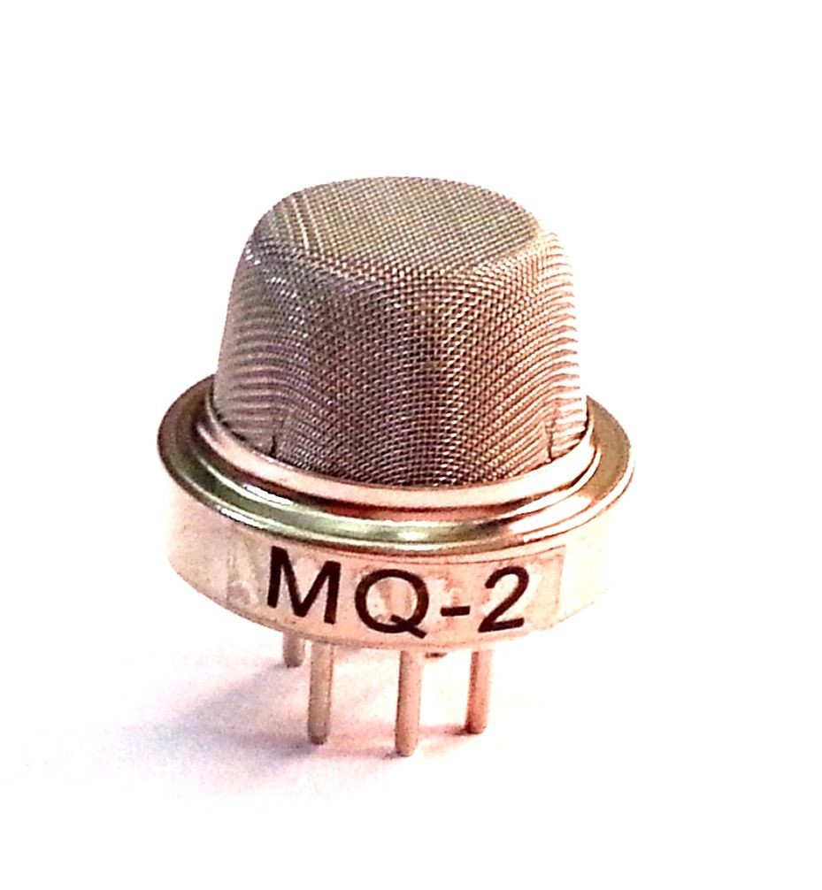
AURDUINO UNO:
Development board speciality target for IoT based application
Open source LUA based firmware
It includes 32 pins
MQ2 GAS SENSOR:
The MQ2 gas sensor operates on 5v DC and consumes approximately 800mW
It can detect LPG,Smoke,Alcohol,Propane, Hydrogen,Methane,Carbon-monoxide concentration ranging from 200-500 ppm

Slide 6

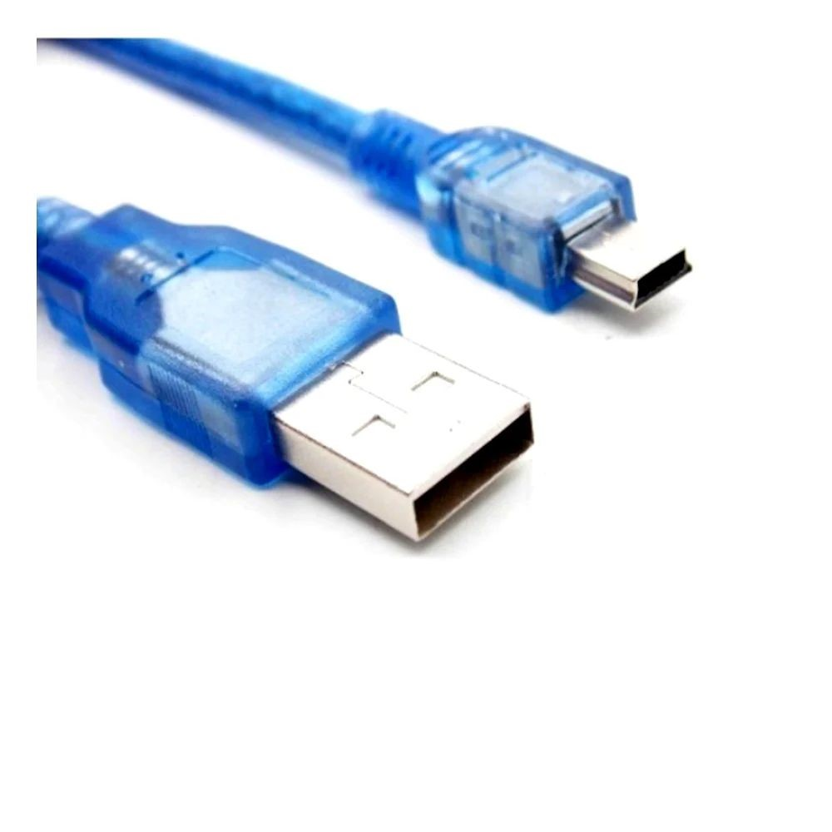
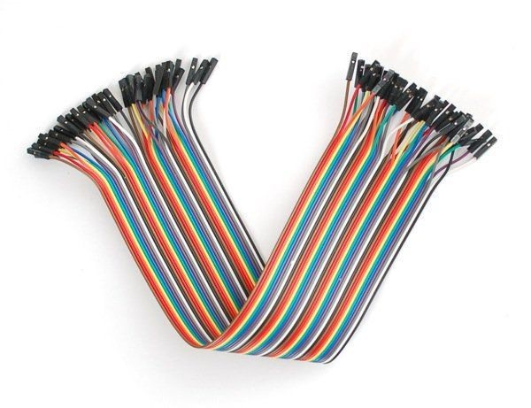
LPG(LIQUEFIED PETROLEUM GAS): LPG is a fuel gas which contains flammable mixture of hydrocarbon gases,specifically propane, propylene,butylene,isobutane and n-butane. The LPG gas is used for cooking(barbecue grills,gas cooktops and ovens )
USB CABLE:
USB, or universal serial bus, is a mechanism used to connect peripheral devices to computers.
WIRES:
A wire is a flexible strand of metal, usually cylindrical. Wires are used for establishing electrical conductivity between two devices of an electrical circuit

Slide 7
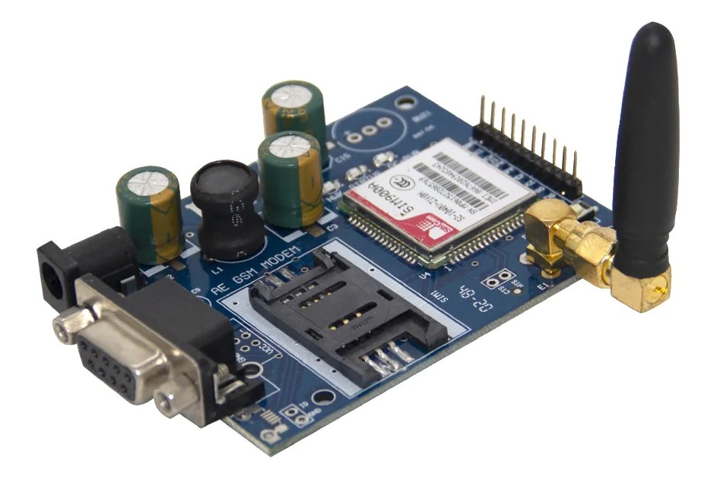
GSM MODULE SIM 900A
SIM900A facilitates GSM/GPRS communication, enabling voice calls, SMS, and GPRS data transmission.
Widely used in IoT, remote monitoring, security systems, and projects requiring remote communication via GSM networks.
Easily interfaces with microcontrollers like Arduino, Raspberry Pi, or standalone systems, enhancing projects with cellular connectivity.

Slide 8
DATA COLLECTION
Sensor Technology: The system utilizes gas sensors equipped with
advanced technologies such as electrochemical sensors, infrared sensors, or
semiconductor sensors. These sensors detect the presence and
concentration of gases such as methane, propane, or carbon monoxide.
Sensor Placement: Sensors are strategically placed in key locations
where gas leaks are most likely to occur, such as near gas pipelines,
appliances, or storage areas. The placement of sensors is critical to ensure
comprehensive coverage and early detection of leaks.
Alert Generation: When the sensors detect abnormal gas levels or
potential leaks, the system generates alerts or notifications to alert users and
stakeholders. Alerts can be sent via various communication channels,
including SMS, email, mobile apps, or audible alarms, depending on the
system's configuration

Slide 9
BLOCK DIAGRAM
MQ-2 Gas Sensor
IOT
Arduino uno board
GSM MODULE SIM 900A
Mobile Notification

Slide 10
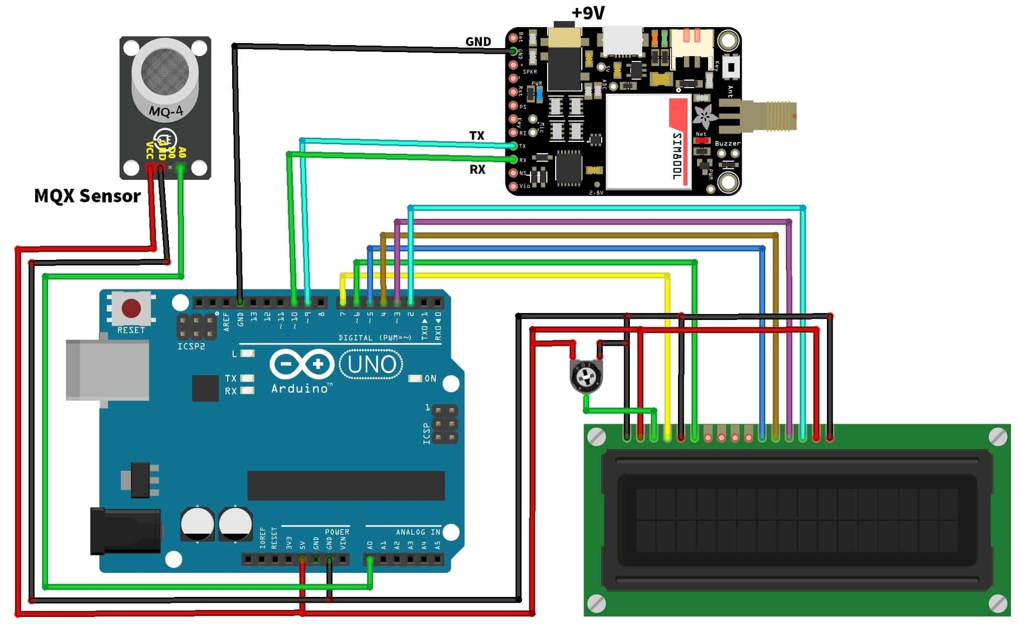
CIRCUIT DIAGRAM

Slide 11
WORKING
Arduino Uno Interface: The Arduino Uno acts as the central processing unit for the system. It interfaces with the MQ2 Gas sensor to read the analog voltage output. Using its built-in Analog-to-Digital Converter (ADC), Arduino converts the analog signal into a digital value that represents the gas concentration.
Data Processing and Threshold Monitoring: Arduino Uno processes the digital sensor data and compares it with predefined threshold levels for gas concentration. If the measured concentration exceeds the threshold indicating a potential gas leak, the Arduino triggers an alarm sequence.
GSM Module Integration: The GSM module SIM900A is interfaced with Arduino Uno to enable communication capabilities. When a gas leak is detected and the alarm is triggered, Arduino sends a notification SMS message to predefined phone numbers using the GSM module. This ensures that users receive immediate alerts about the gas leakage regardless of their location.
Alarm Activation and User Notification: Upon detecting a gas leak and sending the SMS alert, Arduino Uno can activate local alarms such as sirens or LED indicators to provide visual and auditory warnings to people in the vicinity. Additionally, users can remotely monitor the gas leakage status and receive real-time alerts through the SMS notifications sent by the GSM module.

Slide 12
APPLICATION
Industrial Safety: Gas detection sensors are deployed in industrial environments to monitor the presence of toxic, flammable, and combustible gases. They ensure the safety of workers by triggering alarms or initiating shutdown procedures in case of gas leaks.
Environmental Monitoring: Gas sensors are used for monitoring air quality in urban areas, detecting pollutants such as carbon monoxide (CO), nitrogen dioxide (NO2), and sulfur dioxide (SO2). This data helps in assessing environmental health and implementing pollution control measures.
Agriculture: Gas sensors are employed in agriculture for monitoring greenhouse gases, such as methane (CH4) and carbon dioxide (CO2), as well as detecting harmful chemicals in soil and water. This information aids farmers in optimizing crop yields and minimizing environmental impact.

Slide 13
CONCLUSION
The implementation of a smart gas leakage detection system for homes using IoT technology offers a proactive approach to safety and convenience.
By leveraging real-time monitoring, instant alerts, and remote control capabilities, homeowners can mitigate risks associated with gas leaks and ensure the well-being of their families and properties.
Feel free to customize this application according to specific requirements, technologies, or additional features desired for the smart gas leakage detection system.

Slide 14
PROJECT DEMO VIDEO
LINK:https://drive.google.com/file/d/1GQaUjO5Y5rxOeBQMUx61LHkF67v_k57Q/view?usp=drivesdk

Slide 15


